Slide 1

PORT CITY INTERNATIONAL UNIVERSITY
Detecting and Explaining Bangla Idiom Misuse:
A Comparative Study of Neural Approaches with Reason Generation
Supervised by:
Mrs. Farzina Akther
Assistant Professor
Department of CSE
Presented by:
Md. Ashiful Hoque Chowdhury
CSE 02707396
Batch 27A1

Slide 2
CONTENTS
Introduction
Motivation
Objectives
Literature Review
Methodology
Dataset
Used Tools and Platforms
Preprocessing
Feature Extraction
Result and Discussion
Challenges
Conclusion
Future Work
Reference

Slide 3
INTRODUCTION
This study addresses contextual Bangla idiom misuse by introducing a manually annotated dataset with correctness labels and human-written explanations. It benchmarks ML, DL and transformer models and integrates an explainable framework using BanglaT5 to generate human-readable justifications. The work contributes new dataset, empirical baselines and interpretable models for advancing Bangla NLP and educational applications.

Slide 4
MOTIVATION
No automated idiom support for Bangla learners, especially in underserved contexts.
Weak idiom handling in existing Bangla NLP systems, harming downstream tasks.
Severe resource scarcity, with no large annotated idiom datasets or explanation-rich benchmarks.
Lack of explainability in black-box models, limiting educational trust and usability.

Slide 5
OBJECTIVES
Build a Bangla idiom dataset with correct/incorrect labels and short human explanations.
Construct idiom dictionary with meanings and idiom_id.
Generate explainable outputs in Bangla for better human understanding.
Evaluate performance against ML, DL baselines and transformer-based models.

Slide 6
LITERATURE REVIEW
TITLE | AUTHOR | YEAR AND PUBLISHER | FINDINGS
1. Implicit Knowledge-Augmented Prompting for Commonsense Explanation Generation PDF | Y. Ge, H. T. Yu, C. Lei, et al. | 2025, Springer | Aim: To help AI models better explain why certain statements don’t make sense. Dataset Size: ComVE + Commonsense Explanation dataset with ~12,000 sentences. Model Performance: Two-stage Identification and Prompting increases performance over LLMs baselines upto BLEU: ~631%, METEOR: ~192%, ROUGE: ~204%. Limitation: Focused only on explanation generation not classification and also doesn’t handle idioms or non-literal language. Language: English Align: Explanation generation phase after classification.
2. A Hybrid Approach for Bengali Sentence Validation PDF | Juel Sikder, Prosenjit Chakraborty, Utpol Kanti Das, Krity Dhar | 2024, Springer | Aim: Automated grammatical correctness checker for Bengali sentences Dataset Size: Bengali Sentence Validation dataset with ~5,000 sentences. Model Performance: Hybrid CNN + BiLSTM with POS tagging and linguistic rules. Accuracy: ~98%, F1-Score: ~0.98, AUC: ~0.99 Limitation: Struggles with idioms and nonstandard sentences. Language: Bangla. Align: POS and Classification.
3. BanglaBERT: Language Model Pretraining and Benchmarks for Low-Resource Language Understanding Evaluation in Bangla PDF | Abhik Bhattacharjee, Tahmid Hasan, Wasi Uddin Ahmad, Kazi Samin | 2022, NAACL | Aim: BERT-based Natural Language Understanding model pretrained in Bangla. Benchmarked NLU tasks: Text classification, sequence labeling and span prediction. Dataset Size: ~27.5 GB Bangla text from 110 websites. Model Performance: BanglaBERT - BERT model pretrained on Bangla text. Limitation: Limited to Bangla may not generalize well to other languages. Language: Bangla Align: POS tagging, idiom detection and general Bangla embeddings.

Slide 7
LITERATURE REVIEW
TITLE | AUTHOR | YEAR AND PUBLISHER | FINDINGS
4. SemEval-2020 Task 4: Commonsense Validation and Explanation (ComVE) PDF | C. Wang et al. (organizers) | 2020, ACL | Aim: To test if AI can tell what makes sense in language and explain why it doesn’t and mimicking human commonsense reasoning. Dataset Size: ComVE sentence pairs with ~12,000 instances. Model Performance: Subtask A: CN-HIT-IT.NLP – 97.0%, Subtask B: ECNU-SenseMaker – 95.0%, Subtask C: ANA – Human score 2.10/3, BUT-FIT – BLEU 22.4 Limitation: Explanation generation still hard. Language: English. Align: Commonsense validation and explanation.
5. An Empirical Framework of Idioms Translator From Bengali to English: Rule Based Approach PDF | Khatun / Hussain — metadata varies | 2019, Conference 2020, ResearchGate | Aim: To develop a system for translating Bengali idiomic sentences into English using context-sensitive grammar and a top-down parsing algorithm. Dataset Size: Idiom-rich corpora with ~15,000 sentences. Model Performance: Rule-based idiom translation ≈ 85.33% accuracy. Limitation: Limited coverage and weak generalization. Language: Bangla → English. Align: Idiom detection and replace the sentence with literal meaning.
6. An ensemble model for classifying idioms and literal texts using BERT and RoBERTa PDF | J. Briskilal, C. N. Subalalitha | 2022, Elsevier | Aim: To classify idiomatic and literal sentences using an ensemble of pre-trained transformer models. Dataset Size: TroFi dataset with 3,737 sentences and 1,470 expert-annotated sentences. Models Performance: BERT achieved 85% accuracy, RoBERTa achieved 88% accuracy and the ensemble model achieved 90% accuracy. Limitation: Focuses only on binary idiom–literal classification Language: English Align: Idiom vs. literal sentence classification using transformer-based learning.

Slide 8
LITERATURE REVIEW
TITLE | AUTHOR | YEAR AND PUBLISHER | FINDINGS
7. Parts of Speech Tagging in Bengali for MWEs Detection PDF | Primary authors: Abedin, Purkayastha et al. | ~2015 (IJCA Volume 99), International Journal of Computer Applications | Aim: Develop POS tagset and tagging approach for Bengali to detect Multiword. Dataset Size: Not explicitly large-scale (focus on tagset design + examples). Model Performance: Rule layered tagging approach effective for MWEs (Acc: 85%). Limitation: Rule-based and limited scalability. Language: Bangla. Align: Bangla-specific linguistic processing for MWEs/idioms.
8. TituLLMs: A Family of Bangla LLMs with Comprehensive Benchmarking PDF | Shahriar Kabir Nahin et al. | 2025 (arXiv 2502.11187; ACL Findings 2025) | Aim: Introduce first large pretrained Bangla LLMs from Llama-3.2 base. Dataset Size: 5 new benchmarking datasets created. Model Performance: TituLLMs outperform base multilingual versions (Acc: 90%). Limitation: Not always superior to multilingual baselines on all tasks. Language: Bangla. Align: Bangla LLM pretraining + benchmarking.
9. CROW: Benchmarking Commonsense Reasoning in Real-World Tasks PDF | Mete Ismayilzada et al. | 2023, EMNLP (arXiv 2310.15239) | Aim: Create multi-task benchmark evaluating commonsense. Dataset Size: Manually curated multi-task set (details in paper: several subtasks). Model Performance: State-of-the-art models tested and highlights gaps (Acc: 85%). Limitation: Focus on evaluation benchmark, not new model training. Language: English Align: Commonsense reasoning benchmarking in applied tasks.
10. “I’m Not Mad”: Commonsense Implications of Negation and Contradiction PDF | Liwei Jiang, Antoine Bosselut, Chandra Bhagavatula, Yejin Choi | 2021, NAACL | Aim: Introduce ANION dataset for commonsense implications under negation. Dataset Size: Curated examples of negated/contradictory statements. Model Performance: Models struggle with nuanced implications (Acc: 90%). Limitation: English-focused; negation handling remains hard for NLI models. Language: English. Align: Commonsense inference in contradictory/negated language.

Slide 9
METHODOLOGY
4. CLASSIFICATION
ML: SVM, LR, NB, ENSEMBLE
DL: BILSTM, BIGRU, CNN, DNN, ENSEMBLE
TRANSFORMER: BanglaBERT, XLMR, mBERT
5. REASONING GENERATION
Gold + Pseudo Labels
Template-Based Explanations
Neural Rewriter (Bangla T5)
DATASET
Text : 15k
TRAINED MODEL
TRAIN + VAL
TEST
1 PREPROCESSING
Unicode Normalization, Punctuation Unification, Tokenization
3. SPLIT DATASET
(Train 70% - Val 15% - Test 15%)
6. EVALUTION
Accuracy, F1, ROC-AUC For Classification
BLEU/ROUGE For Explanation
AND Matrics
2. FEATURE EXTRACTION
TF-IDF, Word Embeddings
7. SAVE AND EVALUATE
Figure 1: Methodology

Slide 10
DATASET
Table 1: Dataset Analysis Overview
Category | Metric | Value
Overall Statistics | Total Instances | 15,670
 | Total Idioms | 1,316
 | Avg. Sentences per Idiom | 11.91
 | Correct Usage (s_label=1) | 7,836 (50.01%)
 | Incorrect Usage (s_label=0) | 7,834 (49.99%)
 | Avg. Sentence Length | 10.27 words
 | Avg. Reason Length | 18.5 words
Train Split | Instances | 10,969 (70%)
 | Correct Usage | ~5,484
 | Incorrect Usage | ~5,485
Validation Split | Instances | 2,350 (15%)
 | Correct Usage | ~1,175
 | Incorrect Usage | ~1,175
Test Split | Instances | 2,351 (15%)
 | Correct Usage | ~1,177
 | Incorrect Usage | ~1,174
 | Annotation Hours | ~600 person-hours

Slide 11
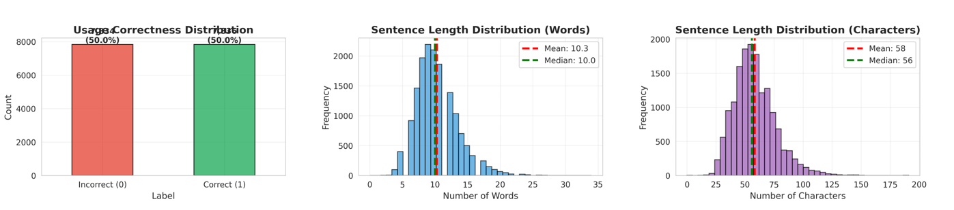
DATASET
Figure 2: Dataset Analysis Plots

Slide 12
DATASET
Dictionary Structure:
{"idiom": "কথার ফুলঝুরি", "meaning": "অতিরিক্ত কথা বলা"}
{"idiom": "চোখের মণি", "meaning": "খুব প্রিয়"}
Dataset Structure:
{"idiom_word": "গভীর জলের মাছ", "idiom_meaning": "চালাক ব্যক্তি", "sentence": "গভীর জলের মাছ ধরার জন্য আমি বড়শি কিনেছি", "i_label": 1, "s_label": 0, "reason": "উক্ত 'গভীর জলের মাছ' বাগধারাটির অর্থ হলো 'চালাক ব্যক্তি', কিন্তু এটি 'আসল মাছ ধরা' বোঝাতে ব্যবহার করা হয়েছে, যা ভুল"}
{"idiom_word": "অগ্নিপরীক্ষা", "idiom_meaning": "কঠিন পরীক্ষা", "sentence": "দীর্ঘদিন রোগভোগের পর সুস্থ হয়ে ওঠাটা ছিল তার জন্য এক অগ্নিপরীক্ষা", "i_label": 1, "s_label": 1, "reason": "উক্ত 'অগ্নিপরীক্ষা' বাগধারাটির অর্থ হলো 'কঠিন পরীক্ষা' এবং এটি সঠিকভাবে ব্যবহৃত হয়েছে।"}

Slide 13
USED TOOLS & PLATFORMS
Development & Training
Google Colab – Cloud GPU & CPU resources
Python 3.10 – Data processing & modeling
Libraries & Frameworks
PyTorch / TensorFlow – Deep Learning
Scikit-learn – ML baselines
BNLTK / Indic NLP – Bangla NLP preprocessing
NumPy / Pandas – Data handling & computation
Data Sources & Support
Bangla Academy Dictionaries & Online Resources
Collaboration & Storage
Google Drive / GitHub – Dataset & model storage
Overleaf / MS Word / LaTeX – Paper writing

Slide 14
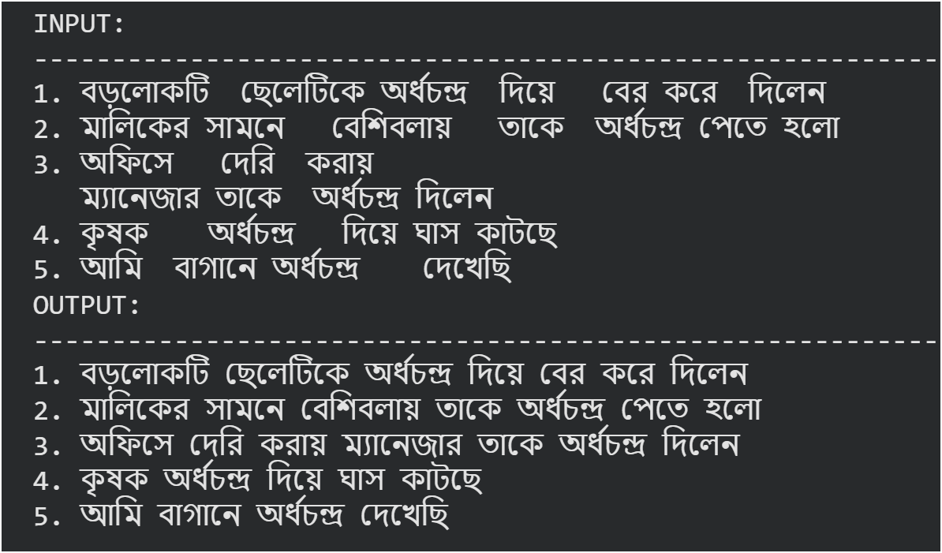
PREPROCESSING
Unicode NFC normalization.
Removal of zero-width characters and whitespace.
Removed duplicates and empty fields.
Figure 3: Preprocessing Result

Slide 15
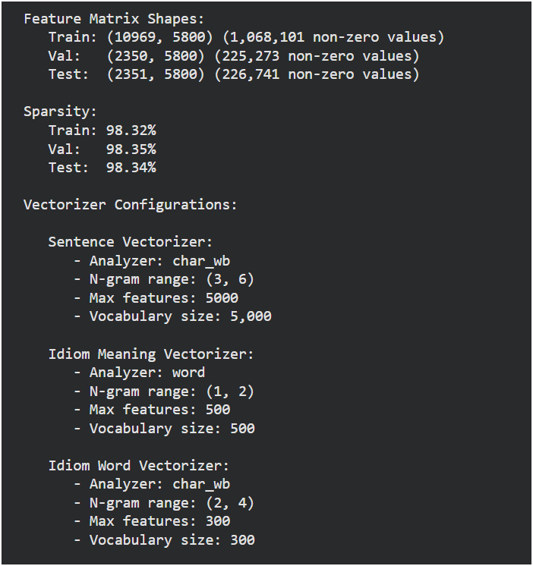
FEATURE EXTRACTION
ML uses TF-IDF to create sparse 5,800-dim vectors from character and word n-grams.
DL models map tokenized sequences, max 180 tokens to dense 128-dim embedding.
Transformers models generate contextual 768-dim embedding using.
Figure 4: Feature Extraction Result

Slide 16
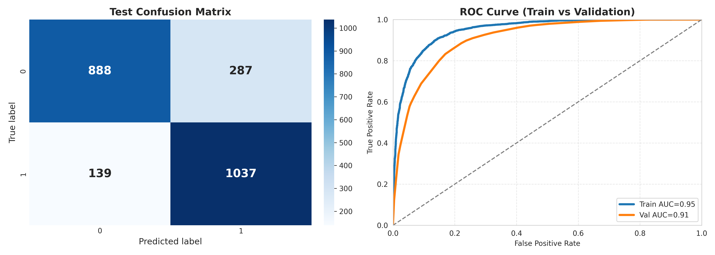

RESULT AND DISCUSSION
LR
SVM
Figure 5: Confusion Matrices and ROC Curve of LR
Figure 6: Confusion Matrices and ROC Curve of SVM

Slide 17
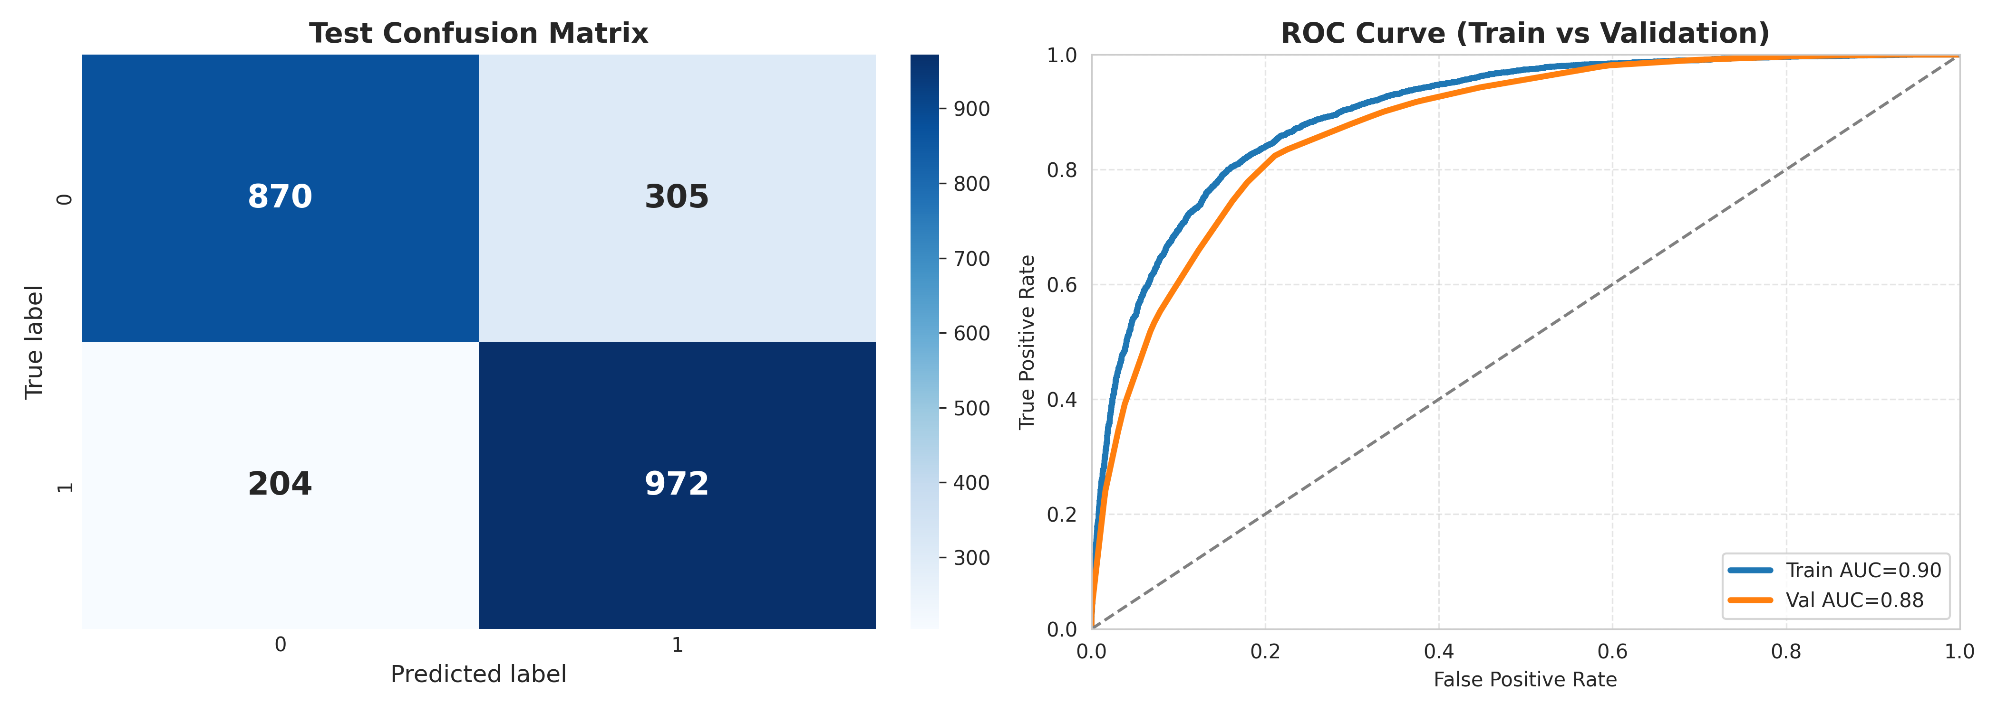
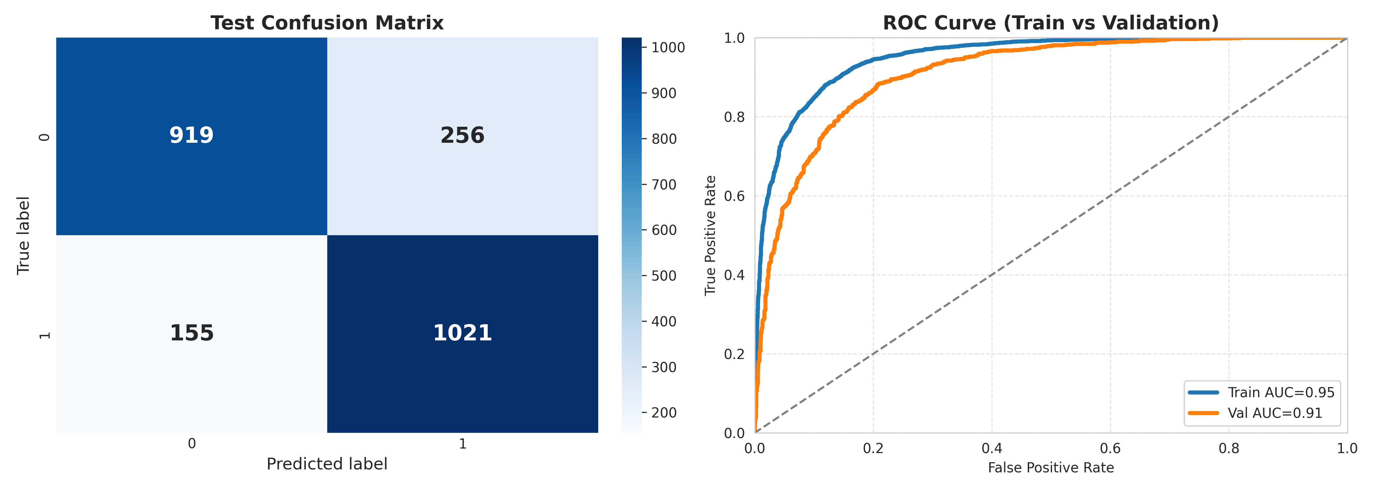
RESULT & DISCUSSION
Naive Bayes
ML ENSEMBLE
Figure 7: Confusion Matrices and ROC Curve of NB
Figure 8: Confusion Matrices and ROC Curve of ML Ensemble

Slide 18
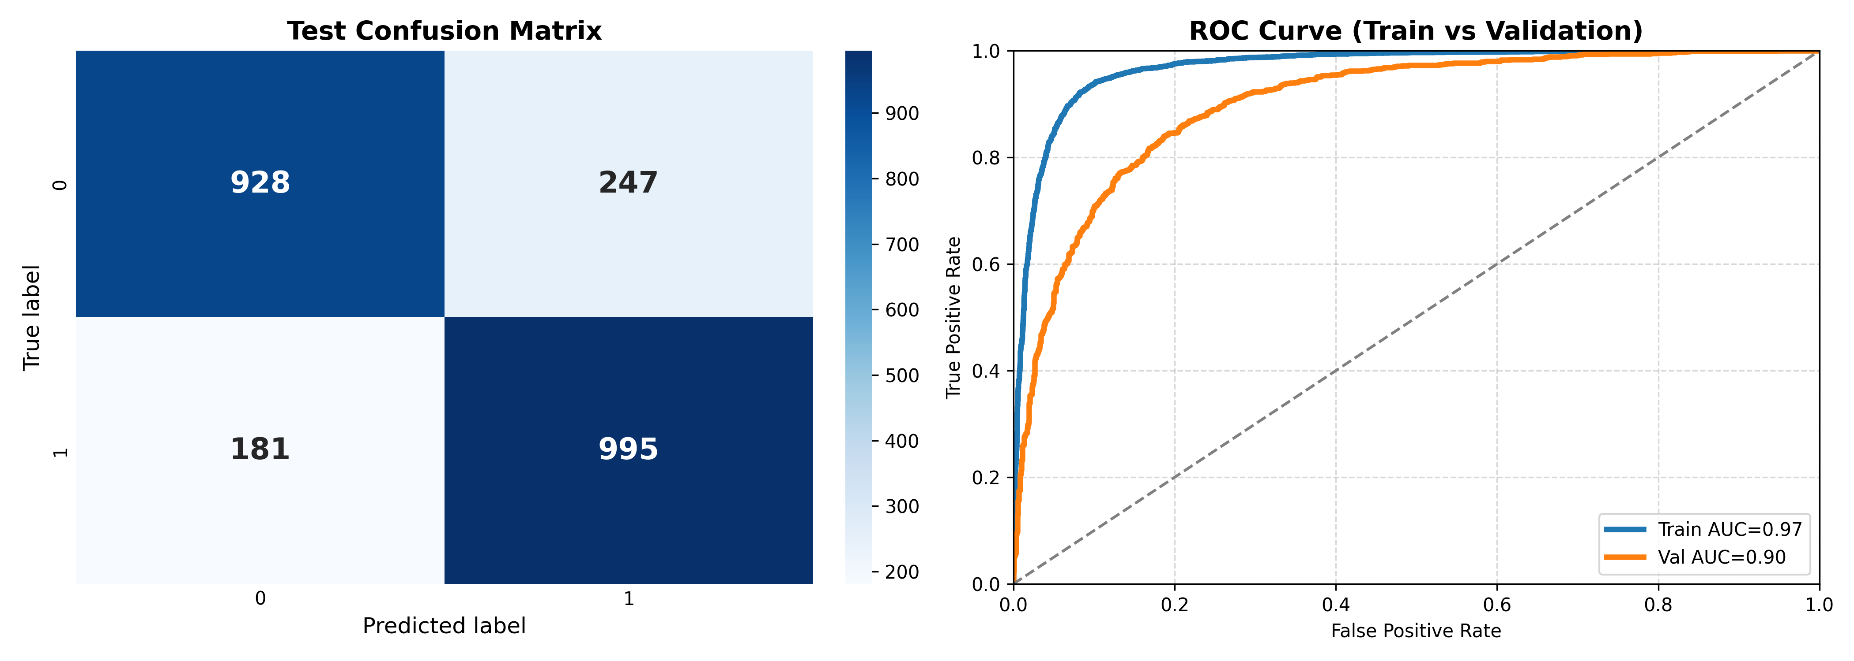
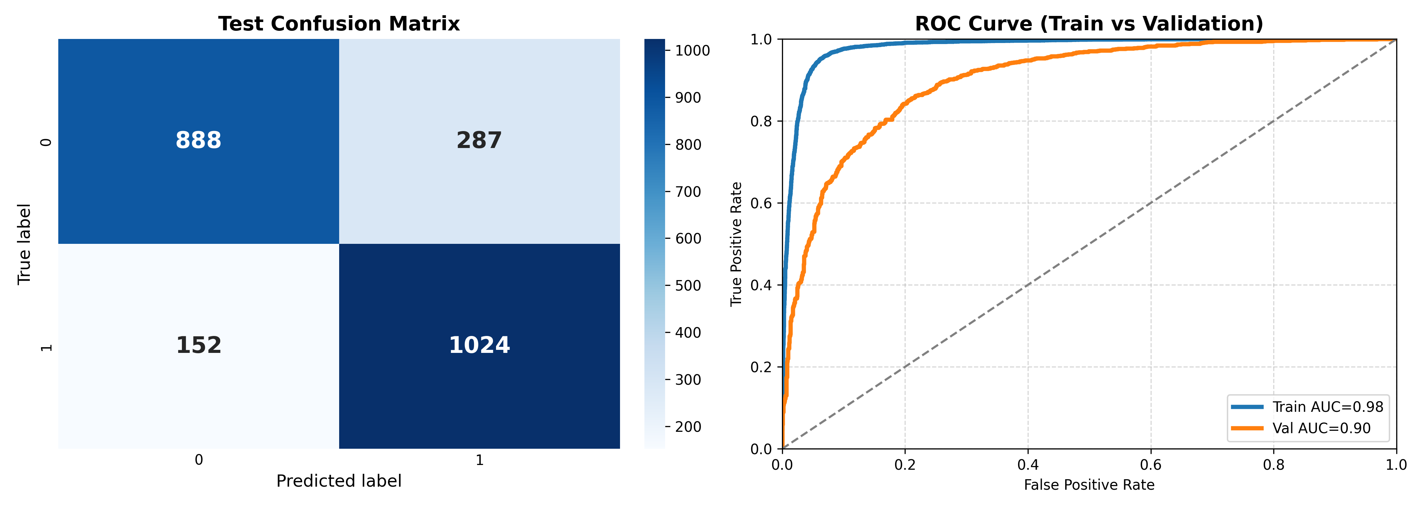
RESULT & DISCUSSION
BILSTM
BIGRU
Figure 9: Confusion Matrices and ROC Curve of BILSTM
Figure 10: Confusion Matrices and ROC Curve of BIGRU

Slide 19

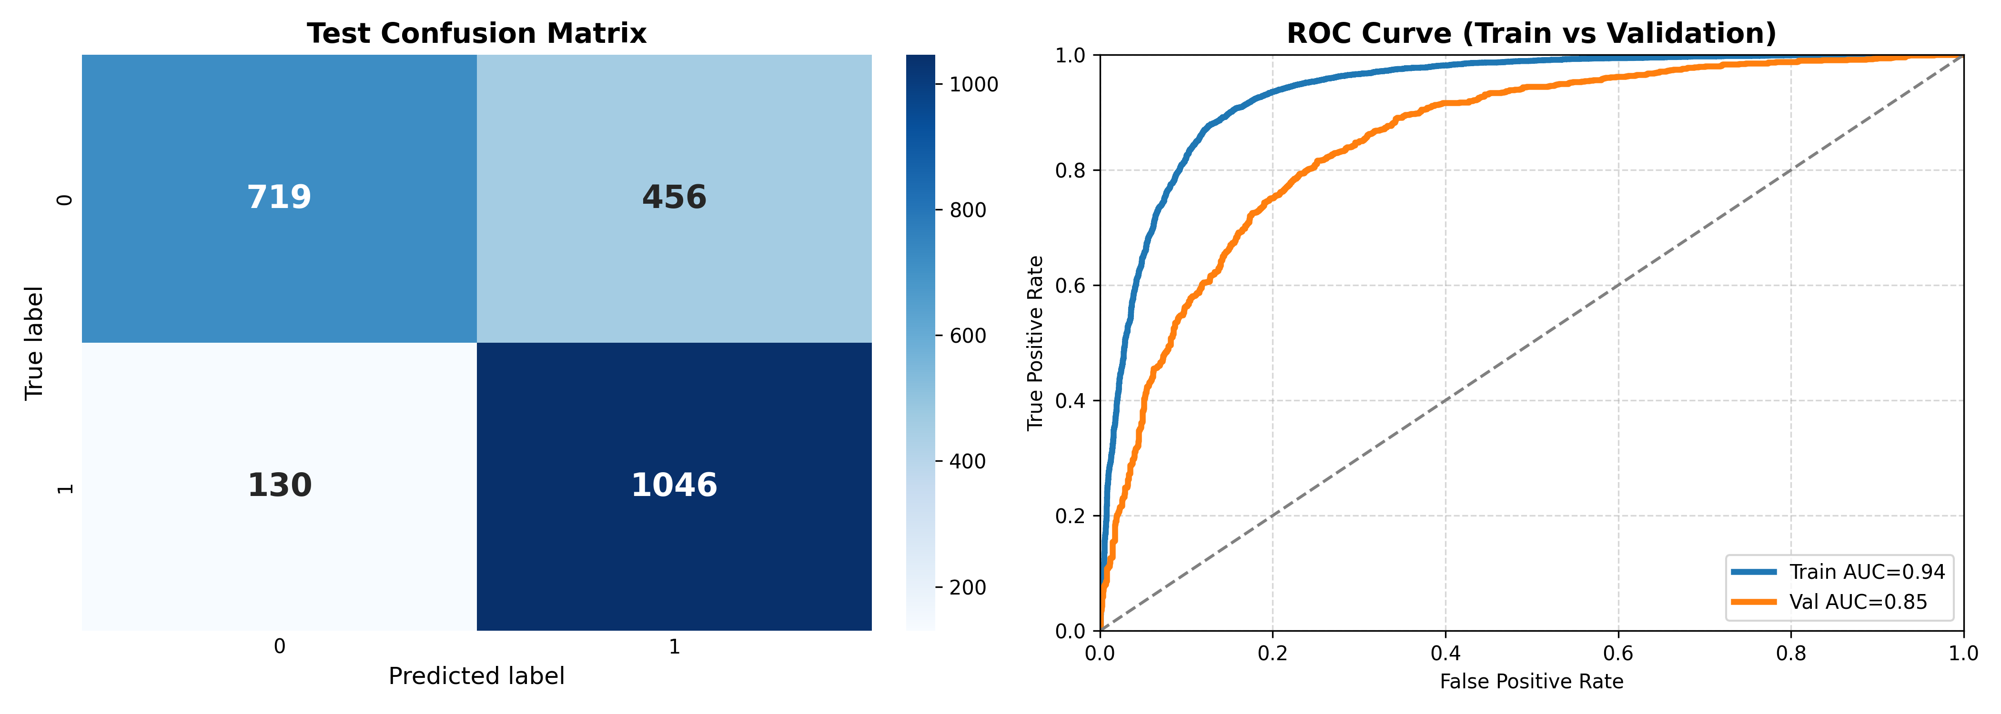
RESULT & DISCUSSION
CNN
DNN
Figure 11: Confusion Matrices and ROC Curve of CNN
Figure 12: Confusion Matrices and ROC Curve of DNN

Slide 20
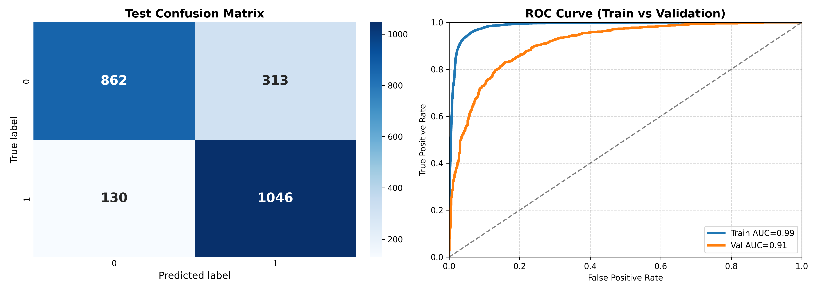
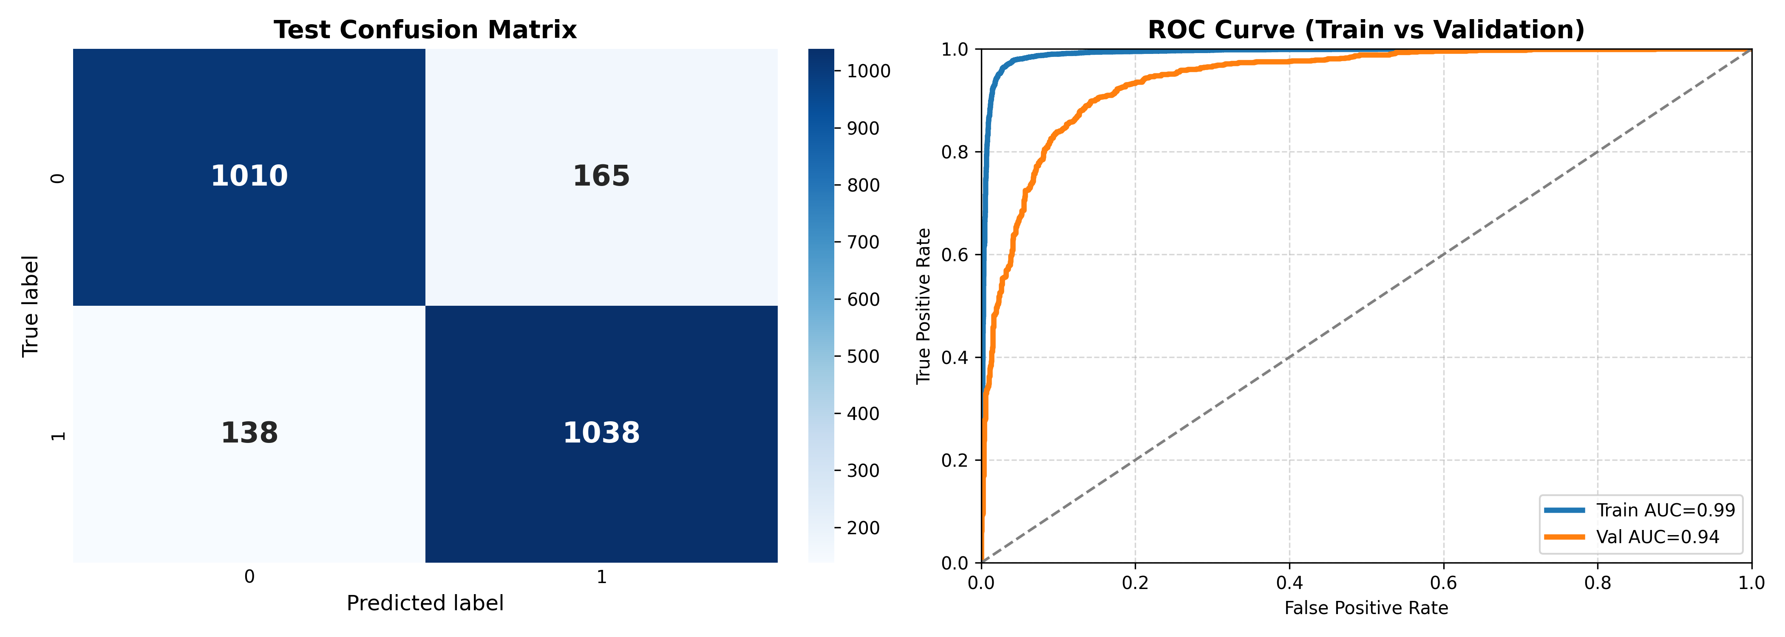
RESULT & DISCUSSION
DL ENSEMBLE
M-BERT
Figure 13: Confusion Matrices and ROC Curve of DL Ensemble
Figure 14: Confusion Matrices and ROC Curve of mBERT

Slide 21
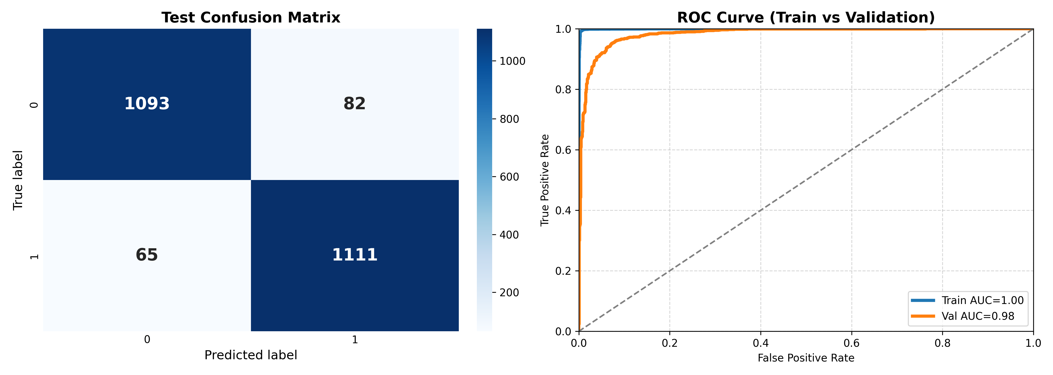
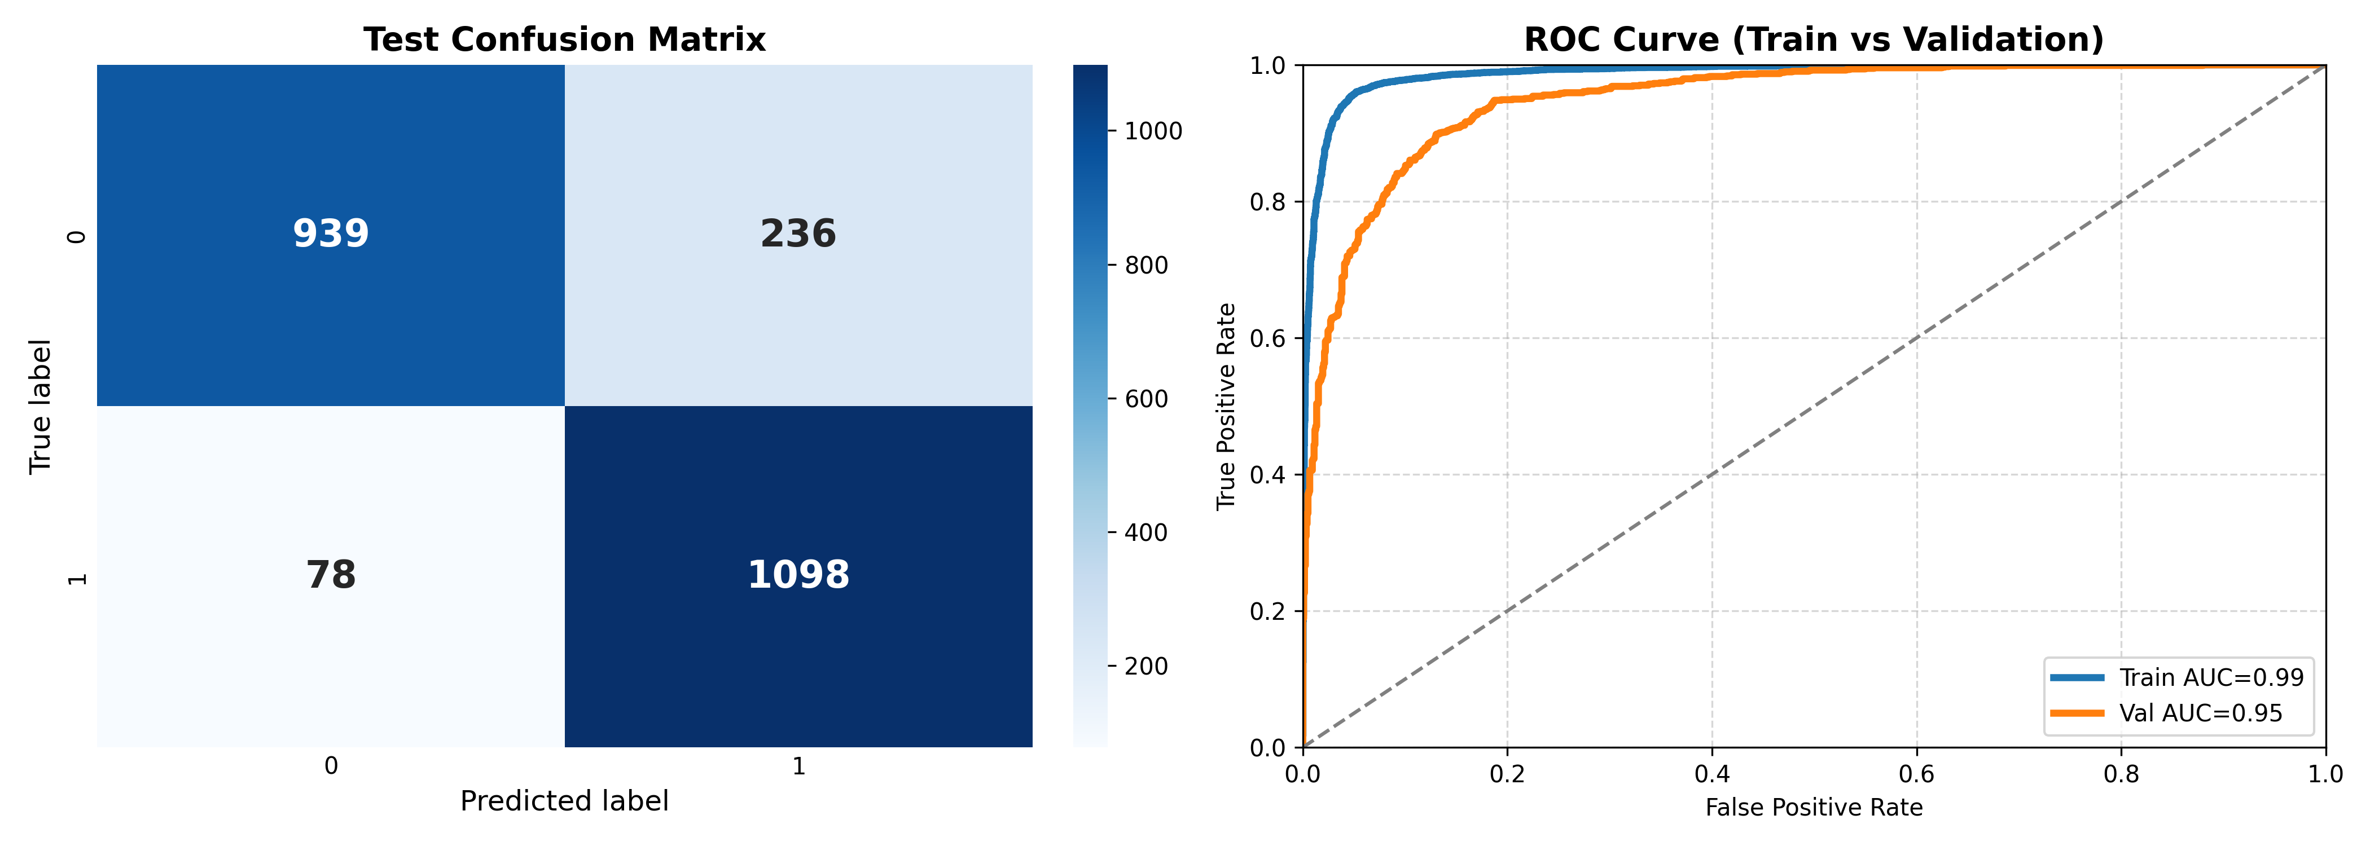
RESULT & DISCUSSION
BanglaBERT
XLM-R
Figure 15: Confusion Matrices and ROC Curve of BanglaBERT
Figure 16: Confusion Matrices and ROC Curve of XLM-R

Slide 22
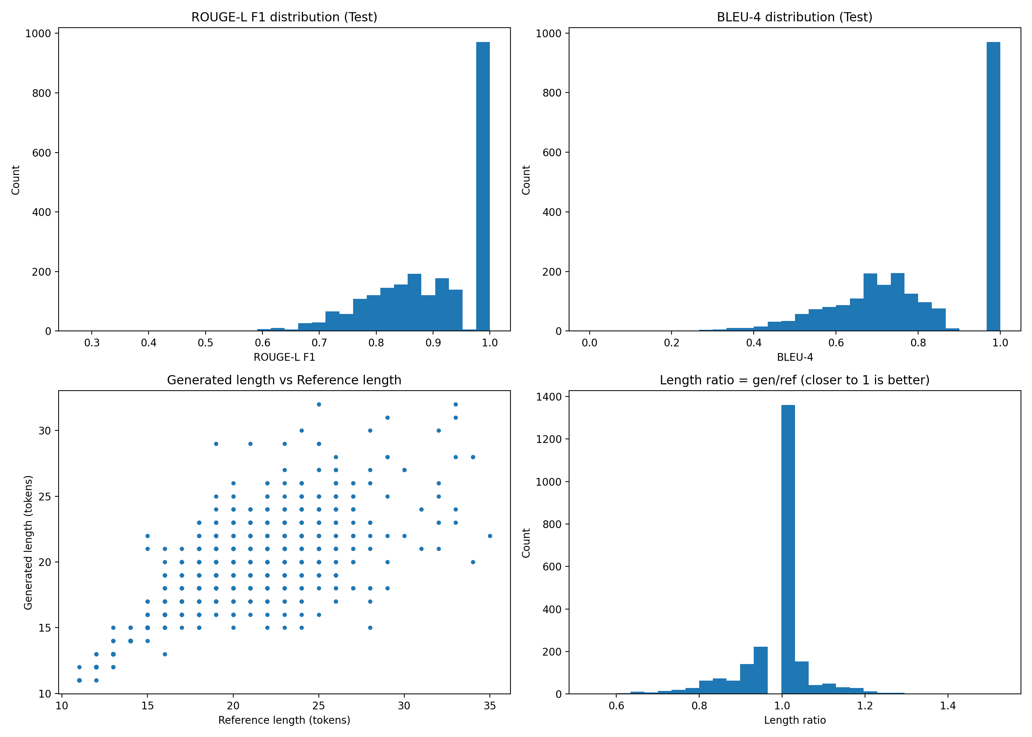
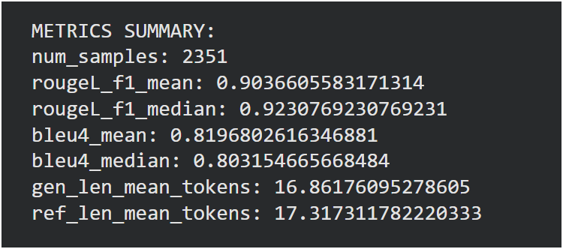
RESULT & DISCUSSION
BanglaT5
Figure 17: Reason Generation Metrics
Figure 18: Classification Report of BanglaT5

Slide 23
RESULT & DISCUSSION
Tabel 2: Performance of Models
Model Type | Model Name | Accuracy | F1-score | ROC-AUC
TRANSFORMER | BanglaBERT | 94% | 94% | 98%
 | XLM-R | 88% | 88% | 95%
 | mBERT | 87% | 86% | 94%
ML | SVM | 83% | 83% | 91%
 | ML Ensemble | 82% | 82% | 91%
 | LR | 83% | 83% | 90%
 | Naive Bayes | 79% | 79% | 87%
DL | DL Ensemble | 83% | 83% | 90%
 | BiLSTM | 82% | 82% | 90%
 | BiGRU | 81% | 81% | 90%
 | DNN | 77% | 78% | 85%
 | CNN | 83% | 83% | 91%

Slide 24
RESULT & DISCUSSION
Tabel 3: Comparative Analysis
Aspect | Briskilal & Subalalitha (2022) | My Work (2026)
Task | Idiom vs. Literal Classification | Idiom Misuse Detection + Explanation
Language | English (high-resource) | Bangla (low-resource, 230M speakers)
Dataset Size | TroFi Dataset ~5,207 sentences | Custom Bangla Dataset ~15,670 sentences
Idioms Covered | 50 English verbs | 1,316 distinct Bangla idioms Manually constructed
Models Evaluated | BERT-base, RoBERTa-base, Ensemble | 3 ML models, 4 DL models, 3 Transformers, 2 Ensembles, BanglaT5
Best Model | BERT + RoBERTa Ensemble | BanglaBERT
Preprocessing | Removed punctuation, Stopwords, Lowercase, Removed punctuation only | Unicode NFC normalization, Zero-width character removal, Whitespace normalization, Punctuation unification, No stop-word removal
Feature Engineering | Pre-trained embeddings only | TF-IDF (5,800 features), Learned embeddings (128-dim), Pre-trained contextual (768-dim)
Accuracy | 90% (Ensemble) | 94% (BanglaBERT)
F1-Score | 89% (Ensemble) | 94% (BanglaBERT)
ROC-AUC | Not reported | 0.99 Validation and 1.00 Training
Explainability | None (Black-box classification) | BanglaT5 achieves ROUGE-L = 0.90 and BLEU-4 = 0.82 on 2,351 samples
Novel Contribution | First BERT + RoBERTa ensemble for idiom classification | First Bangla idiom misuse dataset, First explainable idiom processing, Comprehensive comparative study, Two-stage explanation generation

Slide 25
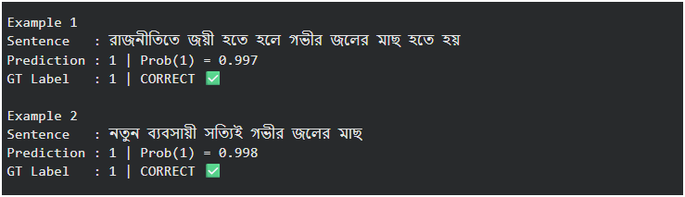
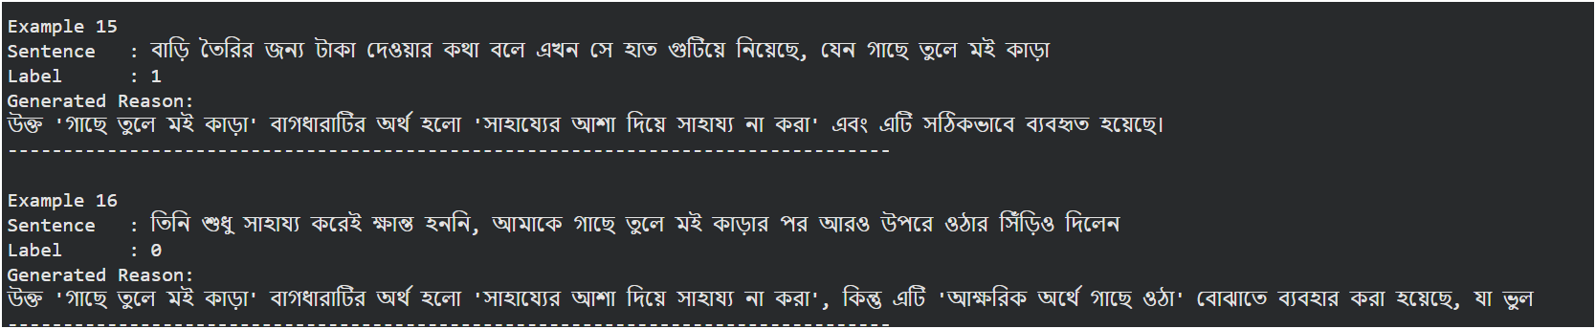
RESULT & DISCUSSION
CLASSIFICATION EXAMPLE:
REASONING EXAMPLE:

Slide 26
CHALLENGES
Context Dependence: Idiom meaning changes with context.
Low-Resource Language: Limited annotated datasets and pre-trained Bangla models.
Data Sparsity: Many idioms appear infrequently, limiting model learning.
Complex Linguistics: Morphological richness and compound word forms in Bangla increase preprocessing and feature extraction complexity.
Explainability: Generating natural, human-aligned reasoning for model predictions is hard.
Generalization: Ensuring models perform well on unseen idioms and diverse text sources.
Computational Constraints: Transformer fine-tuning requires significant GPU resources, which may limit scalability.

Slide 27
CONCLUSION
This research develops a framework for detecting and explaining Bangla idiom misuse using a new dataset of 15,670 sentences. BanglaBERT achieved 94% accuracy and a two-stage BanglaT5 model generated explanations aligned with human reasoning (ROUGE-L mean 0.90). Results show transformer embeddings excel in context understanding, supporting explainable AI for education. The dataset and models could be publicly released for future low-resource language research.

Slide 28
FUTURE WORK
Future work includes expanding the dataset with more idioms, spoken language and fine-grained labels. And also exploring advanced neural models, multimodal, neuro-symbolic approaches. Improving explanation generation with contrastive methods and applying the framework to other low-resource languages and extending techniques to related NLP tasks like metaphor, sarcasm and error analysis.

Slide 29
REFERENCES
[1]Y. Ge et al., “Implicit knowledge-augmented prompting for commonsense explanation generation,” Knowledge and Information Systems, vol. 67, Jan. 2025, doi: https://doi.org/10.1007/s10115-024-02326-w.
[2]J. Sikder, P. Chakraborty, U. K. Das, and K. Dhar, “A hybrid approach for Bengali sentence validation,” Artificial Intelligence Review, vol. 57, no. 11, Oct. 2024, doi: https://doi.org/10.1007/s10462-024-10795-2.
[3]A. Bhattacharjee et al., “BanglaBERT: Language Model Pretraining and Benchmarks for Low-Resource Language Understanding Evaluation in Bangla,” arXiv (Cornell University), vol. 4, Jan. 2022, doi: https://doi.org/10.48550/arxiv.2101.00204.
[4]C. Wang, S. Liang, Y. Jin, Y. Wang, X. Zhu, and Y. Zhang, “SemEval-2020 Task 4: Commonsense Validation and Explanation,” arXiv (Cornell University), vol. 2, Jan. 2020, doi: https://doi.org/10.48550/arxiv.2007.00236.
[6] J. Briskilal and C. N. Subalalitha, “An ensemble model for classifying idioms and literal texts using BERT and RoBERTa,” Information Processing & Management, vol. 59, no. 1, 2022, Art. no. 102756, doi: https://doi.org/10.1016/j.measen.2022.100434.

Slide 30
REFERENCES
[7] A. Abedin and B. S. Purkayastha, “Parts of Speech Tagging in Bengali for MWEs Detection,” International Journal of Computer Applications, vol. 99, no. 17, pp. 1–6, Aug. 2014, doi: 10.5120/17485-8182.
[8] S. K. Nahin et al., “TituLLMs: A Family of Bangla LLMs with Comprehensive Benchmarking,” arXiv preprint arXiv:2502.11187, 2025, doi: https://arxiv.org/abs/2502.11187.
[9] M. Ismayilzada et al., “CROW: Benchmarking Commonsense Reasoning in Real-World Tasks,” in Proceedings of the 2023 Conference on Empirical Methods in Natural Language Processing (EMNLP), Singapore, Dec. 2023, doi: https://doi.org/10.48550/arXiv.2310.15239.
[10] L. Jiang, A. Bosselut, C. Bhagavatula, and Y. Choi, “‘I’m Not Mad’: Commonsense Implications of Negation and Contradiction,” in Proceedings of the 2021 Conference of the North American Chapter of the Association for Computational Linguistics: Human Language Technologies (NAACL-HLT), Online, Jun. 2021, pp. 180–191. doi: https://doi.org/10.48550/arXiv.2104.06511.

Slide 31
THANK YOU

